Slide 1

Linux Fundementals by
Ahmad Khaled Hassanien

Slide 2
Day2 Content
String Processing.
Piping and Redirection.
Vi Editor.
Environment Variables.
Command Quoting
Command Alias, Substitution and History.

Slide 3
String Processing

Slide 4
String Processing
To get number of lines, words or chars in a file, we use the “wc” command.
Syntax: wc [OPTIONS] file_name
Some options:
-l → gets number of lines only
-w → gets number of words only
-c → gets number of char only
Example:
wc -l -w /etc/passwd
>>> 49 76 /etc/passwd

Slide 5
String Processing
To search for a pattern (like a word) in a file(s), we use the grep command.
Syntax: grep [OPTIONS] file_name
Some options:
-r → searches all files in a directory
-i → ignore case sensitivity
-v → invert match
Example:
grep ahmed /etc/group
>>> netdev:x:117:ahmed
ahmed:x:1000:

Slide 6
String Processing
Comman Patterns for grep cmd:
grep ahmed$ /etc/group
>>> gets all lines that end with ahmed
grep ^ahmed /etc/group
>>> gets all lines that begin with ahmed

Slide 7
String Processing
To sort text in a text file without altering the original file, use sort command. It displays the results to the standard output (terminal).
Syntax: sort [options] file_name
Some options:
-k → filed number to sort with
-t → delimiter
-r → reverse sorting
Example:
sort /etc/passwd

Slide 8
String Processing
To get certain fields from a text file without altering the original file, use cut cmd. It displays the results to the standard output (terminal).
Syntax: cut [options] file_name
Some options:
-f → field 0r column you want to retrieve
-d → delimiter
Example:
cut -f1,3 -d: /etc/passwd

Slide 9
Piping and Redirection

Slide 10
Piping and Redirection
The pipe “|” is used to send the output of a command as an input to another command.
Examples:
ls /etc | more
cat /etc/passwd | grep ^ahmed | wc -l

Slide 11

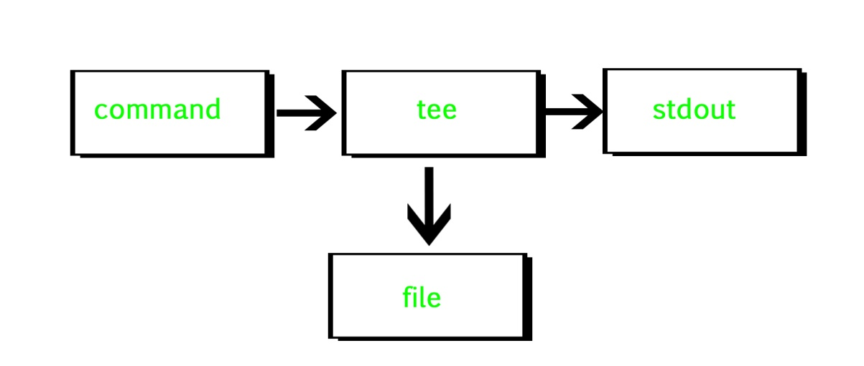
Piping and Redirection
The “tee” cmd reads the standard input and writes it to both the standard output and one or more files. The command is named after the T-splitter used in plumbing.

Slide 12
Piping and Redirection
Examples:
ls /etc | tee etc_content
cat /etc/passwd | grep ^ahmed | tee file | wc -l

Slide 13
Piping and Redirection
To redirect the output of a command we use:
> → used to redirect standard output (overwrite)
>> → used to redirect standard output (append)
2> → used to redirect standard error (overwrite)
2>> → used to redirect standard error (append)
< → Input redirection

Slide 14
Piping and Redirection
Examples:
echo “line 1” > file
echo “line 2” >> file
ls /foo 2> err_file
mail -s "Subject" foo@test.com < file_name
ls / >> file 2>&1 (What does this command do?)

Slide 15
Vi Editor

Slide 16
Vi Editor
The VI editor is the most popular and classic text editor in the Linux family. Below, are some reasons which make it a widely used editor:
Available in almost all Linux distros.
Only editor available in rescue mode.

Slide 17
Vi Editor
Most common commands:
i → inserts text before the cursor
dd → cuts the line containing the cursor
yy → yank a copy of a line
p,P → put yanked text under/above the line
containing the cursor.
D → Deletes the line from the cursor to the right
end of the line
:n,nd → Deletes Lines n through n
:%d → Delete all lines

Slide 18
Vi Editor
/string → searches forward for a string
n → searches for the next occurrence of
a string
N → searches for the previous occurrence
of a string
:set nu, :set nonu → shows and hide lines number
:w → save the file
:q! → quit file without saving
:wq! → save and quit file

Slide 19
Environment Variables

Slide 20
Environment Variables
In Linux and Unix based systems environment variables are a set of dynamic named values, stored within the system that are used by applications launched in shells or subshells. In simple words, an environment variable is a variable with a name and an associated value.
Example: export VAR=value
To get the value: echo $var or printenv VAR
To unset the variable, use “unset” cmd.

Slide 21
Environment Variables
Note that using export will only make the variable accessible within the terminal, to make those variables persistent (available in all terminals) edit ~/.bashrc file.
Example:
Open ~/.bashrc file → vi ~/.bashrc
Add to the end of file → export VAR=value
Save and quit → :wq!
Open terminal and write → printenv VAR

Slide 22
Environment Variables
Some built-in shell environment variables:
$PWD
$HOME
$USER
$PATH
$SHELL

Slide 23
Command Quoting

Slide 24
Command Quoting
Quoting is the process to tell the shell to escape metacharacters (chars with special meaning).
‘’ → strong quoting ignores all metacharacters
“” → weal quoting, ignore all except \ or $ or ‘
\ → prevents the shell from interpreting the
next character as a metacharacter

Slide 25
Command Alias,Substitution and History

Slide 26
Command Alias, Substitution and History
To set an alias for the command, use “alias” command.
Example: alias q=“ls –a”
Unset alias → unalias q
Bybass alias → \q

Slide 27
Command Alias, Substitution and History
Command Substitution allows you to use command inside a command.
Syntax: cmd [options] [arguments] $(other_cmd)
Examples:
rm -r $(ls)
echo "date is" $(date)

Slide 28
Command Alias, Substitution and History
Your commands history can be viewed using the “history” command or viewing the “~/.bash_history ” file.
Some notes:
!! → repeates last command
!n → repeats a command by its number in history
!-n → repeats command n commands back

Slide 29
Thank you Any questions?

